Slide 1


CAPSTONE PROJECT
PLANT LEAF DISEASE DETECTION USING DEEP LEARNING
PRESENTED BY: GOLLA ADISESHU
COLLEGE NAME: BITS PILANI UNIVERSITY
DEPARTMENT: DESIGN & COMPUTING
EMAIL ID: SAMSONSESHUGOLLA@GMAIL.COM
AICTE STUDENT REGISTRATION ID:
STUDENT ID: AINSI_95959
MAY–2025

Slide 2

Index
Abstract
Introduction
Problem statement
Existing System
Proposed System
Methodology
Modules
Software and hardware Requirements
Conclusion
Future Scope

Slide 3

ABSTRACT
One of the important and tedious task in agricultural practices is detection of disease on crops. It requires huge time as well as skilled labor. This paper proposes a smart and efficient technique for detection of crop disease which uses computer vision and machine learning techniques. The proposed system is able to detect different diseases of plants with 95% accuracy.
Our project proposes a deep learning-based solution, leveraging Convolutional Neural Networks (CNNs), to automatically detect and classify plant leaf diseases from images.
CNNs are capable of learning complex patterns from image data, eliminating the need for manual
feature extraction.
Key Words: Digital image processing, CNN, Machine learning, Plant disease detection.

Slide 4
Introduction
Plant diseases can reduce crop yields, affecting food security. Traditional manual inspection is slow, inconsistent, and requires expert knowledge. Deep learning, especially CNNs, provides scalable and automated solutions.
The main objectives of the project included collecting a dataset of plant leaf images
representing various disease categories, applying preprocessing and augmentation techniques to improve data quality, and training multiple deep learning models, primarily using Convolutional Neural Networks (CNNs). The project also aimed to compare the performance of different architectures and analyze their effectiveness, accuracy, and potential limitations.
The methodology involved stages such as dataset preparation, model training, validation, and testing. The final model was integrated into a user-friendly application to allow for real- time disease prediction from uploaded images.

Slide 5
Problem Statement
Manual disease identification is time-consuming, labor-intensive, and highly prone to human error. There’s a lack of accessible and affordable tools for small-scale farmers to diagnose plant diseases at an early stage.
Visual symptoms of many plant diseases are often similar, making it difficult even for experts to differentiate without proper tools.
Most farmers do not have access to agricultural specialists or plant pathologists, especially in rural areas.
Delays in identifying diseases lead to widespread infection, causing substantial crop loss and reduced productivity.

Slide 6
Existing System
In the current agricultural ecosystem, most farmers rely on manual inspection of plants to detect diseases. This approach requires expert knowledge and is often time-consuming, expensive, and prone to human error. Some farmers may not be able to recognize early signs of plant disease, which can result in major crop losses.
Traditional methods involve:
Real time detection and accuracy.
Automation and intelligent decision making.
Proper disease classification and user friendly feedback.
Visual identification of leaf spots, color changes, or damage.

Slide 7
Proposed System
The proposed system is an automated plant leaf disease detection model using Convolutional Neural Networks (CNN) integrated with a user-friendly Streamlit web application. This system processes images of plant leaves and accurately classifies them into healthy or diseased categories.
Deep Learning-based Detection: Utilizes a CNN model trained on a large dataset of leaf images to detect and classify plant diseases with high accuracy.
Multi-Crop Support: The model is trained on a variety of plant leaf types, not limited to a single crop like tomato. It can detect multiple plant diseases.
High Accuracy & Speed: Achieves over 95% validation accuracy, ensuring reliable and fast detection during real-time testing.
User-Friendly Interface: Implements Streamlit for a simple and clean UI, allowing users to upload images and get disease predictions instantly.
OpenCV Integration: Helps in preprocessing of images like resizing, normalization, and color adjustments to enhance model performance.

Slide 8
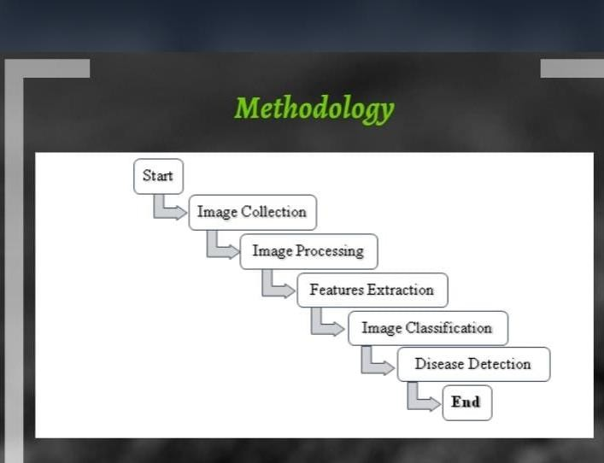
Methodology

Slide 9
Methodology
Input Layer: Users upload a leaf image (via streamlit interface).
Preprocessing Layer: Uses OpenCV and NumPy to resize and normalize , and convert images into suitable format for the model.
Model Loading: The trained CNN model(.h5 or keras file) is loaded using tensorflow/keras.
Prediction Layer: The image is passed through the model to predict the class(healthy or specific disease).
Result Display: The predicted result(disease name)is shown to the user on the streamlit wed application.
Data Flow: User → streamlit → preprocessing → CNN Model → Output Prediction → display.
Technology Stack Used: Python, Tensor Flow , Keras, Open CV, NumPy, Streamlit, Jupyter Notebook

Slide 10
Modules
Collected diverse tomato leaf images (healthy & diseased).
Applied image resizing (256×256), normalization, and histogram equalization.
Enhanced dataset variety using data augmentation (rotation, flipping, scaling).
Used K-means clustering for image segmentation.
CNN achieved highest accuracy (96%) with strong generalization.
Layers: Convolution → ReLU → Pooling → Fully Connected.
Improved convergence with batch normalization.
Used cross validation and performance matrix.

Slide 11
Requirements
Software requirements:
Programming Language
Python 3.11
Core language for data preprocessing, model training, and deployment.
Libraries & Frameworks
TensorFlow / Keras – Deep learning model building & training
NumPy – Numerical computations
Pandas – Data handling and analysis
OpenCV – Image processing
Matplotlib – Visualization of results and metrics
Scikit-learn – Evaluation metrics and classical ML models (SVM)
Development Tools
Jupyter Notebook – Interactive coding and model experimentation
Visual Studio Code (VS Code) – Code editing and debugging
IntelliJ IDEA – Alternative IDE for Python development
Web Framework & API
FastAPI – For serving the trained model as a REST API
Streamlit – For building the web-based user interface
Hardware requirements:
PROCESSOR: Intel core i5(7th Gen or above).
RAM: 8GB.
Storage: 512GB.
GPU: Integrated GPU(for better performance)
Operating System: Windows10

Slide 12

Execution
Requires plant leaf images from data set.
Labelled Data into Categories: Healthy, Early Bright, Late Bright.
Applied techniques: Dropout layer and Batch Normalization.
Evaluation Metrics: accuracy 96%.
Deployment: Frontend

Slide 13
Conclusion
The project successfully demonstrates the potential of deep learning in automating plant disease detection using tomato leaf images. By leveraging Convolutional Neural Networks (CNNs), the system achieved a remarkable accuracy of 96%, outperforming traditional machine learning models like SVM .
Through effective preprocessing, data augmentation, and the use of modern architectures such as ResNet, the model was able to learn intricate patterns and classify diseases with high precision. The integration of a Streamlit-based user interface and FastAPI backend ensures that the system is both user-friendly and deployment-ready.
This work not only empowers farmers with a reliable tool for real-time disease detection but also contributes to sustainable agriculture by reducing crop losses and promoting timely intervention.

Slide 14
Future Scope
Expand the model to include more crops.
Improve detection at early stage.
Integrate with sensors and drones for automated diseases.
Deploy the model on edge devices for offline use in remote agricultural areas.
Develop an Android/Ios app to detect diseases.
Note : My GitHub link is https://github.com/GollaAdiseshu

Slide 15
Thank You

